Slide 1
Text Files
Principles of programming

Slide 2
Introduction
In this section we will review how to work with text files in C#.
What a stream is, what its purpose is, and how to use it.
What a text file is and how can you read and write data to a text file and how to deal with different character encodings.
We will demonstrate and explain the good practices for exception handling when working with files.

Slide 3
Streams
Streams are an essential part of any input-output library.
You can use streams when your program needs to "read" or "write" data to an external data source such as files, other PCs, servers etc.
It is important to say that the term input is associated with reading data, whereas the term output is associated with writing data.

Slide 4
What Is a Stream?
A stream is an ordered sequence of bytes, which is send from one application or input device to another application or output device. These bytes are written and read one after the other and always arrive in the same order as they were sent.
Streams are an abstraction of a data communication channel that connects two devices or applications.
Streams are the primary means of exchanging information in the computer world. Because of streams, different applications are able to access files on the computer and are able to establish network communication between remote computers. In the world of computers, many operations can be interpreted as reading and writing to a stream.
For example:
Printing is a process of sending a sequence of bytes to a stream, associated with the corresponding port, to which is the printer connected.
Recreating sounds from the computer’s sound card can be done by sending some commands, followed by the sample sound, which is actually a sequence of bytes.

Slide 5
What Is a Stream?
Every time when you read or write from or to a file, you have to open a stream to the corresponding file, do the reading or writing, and then close the stream.
There are two types of streams – text streams and binary streams but this separation has to do with the interpretation of the sent and received bytes. Sometimes, for convenience, a sequence of bytes can be treated as text (in a predefined encoding) and is referred to as a text stream.
Today’s modern web sites cannot do without the so-called streaming, which represents stream access to bulky multimedia files coming from the Internet.
Streaming audio and video allows files to be played before they are downloaded locally, making the site more interactive. Streams and media streaming are different concepts but both use sequences of data.

Slide 6
Basic Operations with Streams
Creation
To create or open a stream means to connect the stream to a data source, a mechanism for data transfer or another stream.
For example, when we have a file stream, then we pass the file name and the file mode in which it is to be opened (reading, writing or reading and writing simultaneously).

Slide 7
Basic Operations with Streams
Reading
Reading means extracting data from the stream. Reading is always performed sequentially from the current position of the stream.
Reading is a blocking operation, and if the other party has not sent data while we are trying to read or the sent data has not yet arrived, there may occur a delay – a few milliseconds to hours, days or greater.
For example, when reading from a network stream data can be slowed down because of the network or the other party might not have send any data.

Slide 8
Basic Operations with Streams
Writing
Writing means sending data to the stream in a specific way.
The writing is performed from the current position of the stream.
Writing may be a potentially blocking operation, before the data is sent on its way.
For example, if you send bulk data via a network stream, the operation may be delayed while the data is traveling over the network.

Slide 9
Basic Operations with Streams
Positioning
Positioning or seeking in the stream means to move the current position of the stream.
Moving is done according to the current position, where we can position according to the current position, beginning of the stream, or the end of the stream.
Moving can be done only in streams that support positioning.
For example, file streams typically maintain positioning while network streams do not.

Slide 10
Basic Operations with Streams
Closing
To close or disconnect a stream means to complete the work with the stream and releases the occupied resources.
Closing must take place as soon as possible after the stream has served its purpose, because a resource opened by a user, usually cannot be used by other users (including other programs on the same computer that run parallel to our program).

Slide 11
Binary Streams
Binary streams, as their name suggests, work with binary (raw) data. You probably guess that that makes them universal and they can be used to read information from all sorts of files (images, music and multimedia files, text files etc.).
The main classes that we use to read and write from and to binary streams are: FileStream, BinaryReader and BinaryWriter.
The class FileStream provides us with various methods for reading and writing from a binary file (read / write one byte and a sequence of bytes), skipping a number of bytes, checking the number of bytes available and, of course, a method for closing the stream. We can get an object of that class by calling him his constructor with parameter - a file name.
The class BinaryWriter enables you to write primitive types and binary values in a specific encoding to a stream. It has one main method – Write(…), which allows recording of any primitive data types – integers, characters, Booleans, arrays, strings and more.
BinaryReader allows you to read primitive data types and binary values recorded using a BinaryWriter. Its main methods allow us to read a character, an array of characters, integers, floating point, etc. Like the previous two classes, we can get on object of that class by calling its constructor.

Slide 12
Text Streams
Text streams are very similar to binary, but only work with text data or rather a sequence of characters (char) and strings (string). Text streams are ideal for working with text files.
On the other hand, this makes them unusable when working with any binaries.
The main classes for working with text streams in .NET are TextReader and TextWriter. They are abstract classes, and they cannot be instantiated.
These classes define the basic functionality for reading and writing for the classes that inherit them. Their more important methods are:
ReadLine() – reads one line of text and returns a string.
ReadToEnd() – reads the entire stream to its end and returns a string.
Write() – writes a string to the stream.
WriteLine() – writes one line of text into the stream.

Slide 13
StreamReader or StreamWriter
The classes, to which we will turn our attention to in this chapter, are StreamReader and StreamWriter.
They directly inherit the TextReader and TextWriter classes and implement functionality for reading and writing textual information to and from a file.
To create an object of type StreamReader or StreamWriter, we need a file or a string, containing the file path.
Working with these classes, we can use all of the methods that we are already familiar with, to work with the console.
Reading and writing to the console is much like reading and writing respectively with StreamReader and StreamWriter.

Slide 14
Relationship between Text and Binary Streams
When writing text, hidden from us, the class StreamWriter transforms the text into bytes before recording it at the current position in the file. For this purpose, it uses the character encoding, which is set during its creation.
The StreamReader class works similarly. It uses StringBuilder internally and when reading binary data from a file, it converts the received bytes to text before sending the text back as a result from reading.
Remember that the operating systems have no concept of "text file". The file is always a sequence of bytes, but whether it is text or binary depends on the interpretation of these bytes. If we want to look at a file or a stream as text, we must read and write to it with text streams (StreamReader or StreamWriter), but if we wish to treat it as binary, we must read and write with a binary stream (FileStream).
Bear in mind that text streams work with text lines, that is, they interpret binary data as a sequence of text lines, separated from each other with a new line separators.

Slide 15
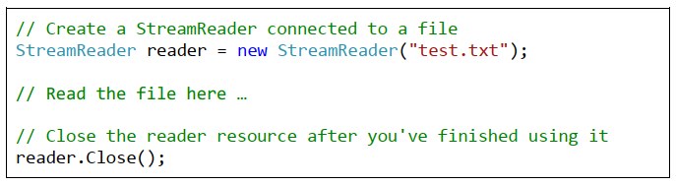
Opening a Text File for Reading
You can simply create a StreamReader from a filename (or full file path), which greatly eases us and reduces the probability of an error. On its creation, we can specify the character encoding

Slide 16
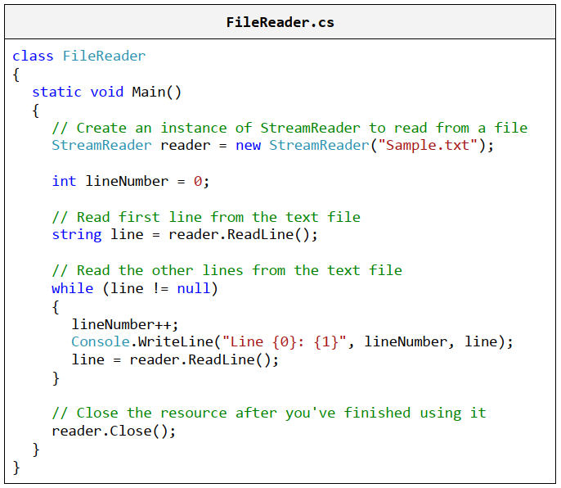
Reading a Text File Line by Line

Slide 17
Reading a Text File Line by Line
Live demo …

Slide 18
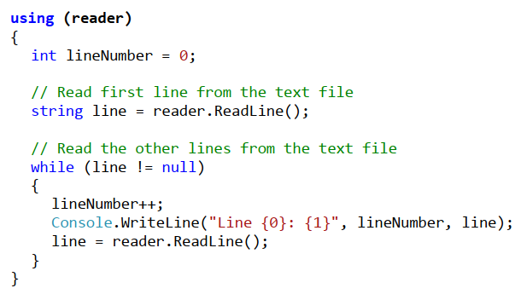
Automatic Closing of the Stream
Having finished working with the object of type StreamReader, we called Close() and closed the stream behind the StreamReader object.
Very often, however, novice programmers forget to call the Close() method, thus blocking the file they use. Also in case of runtime exception when reading from a file, the file might be left open.
This causes resource leakage and can lead to very unpleasant effects like program hanging, program misbehavior and strange errors.
The correct way to handle the file closing is though the using keyword

Slide 19
Exercise
Create a program that
Allow user to enter information about students from the console
Store data into text file
Reads information about students from text file
FirstName
LastName
StudentNumber
Display information on console

